Slide 1


Predicting Breast Cancer Survival Period and Recommending Treatments
Fady Smouni
Rishu Gandhi
Design and Implementation of Analytics System (Fall, 2021)
Instructor: Dr. Robin Qiu

Slide 2
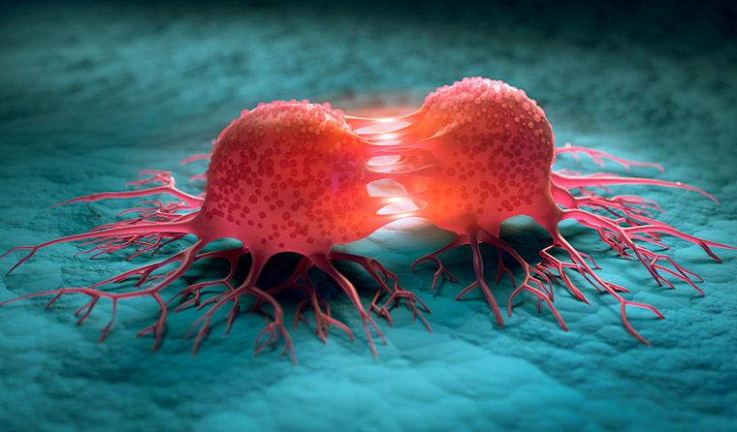
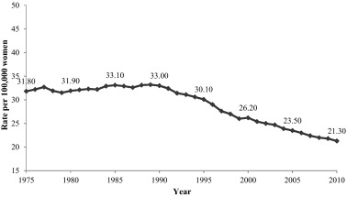
2 min to convince the audience
1 IN 8 (13%)
Mortality rates
https://www1.racgp.org.au/getattachment/8e4a0311-e904-45b2-9871-c46b0c43edc8/attachment.aspx
https://ars.els-cdn.com/content/image/1-s2.0-S2213538315000065-gr1.jpg
Notes:
Rishu
Research shows that breast cancer can affect 1 in 8 U.S. women.
Second leading cause of deaths related to cancer for women (first is lung cancer)
Significant progress has been achieved over the past decades, bringing survival rates higher and allowing patients to live longer.
we aim to help drive this progress further by providing a clearer picture between patient survival and life extension in relation with the various available treatments.

Slide 3
Objectives
We aim to perform classification based on various parameters to determine a survival range for the patient.
We would also like to try and perform a regression analysis to see If it is possible to predict how long a patient will survive in months.
Try to explore the use of Bayesian Networks in the understanding which treatment(s) could most likely prolong breast cancer patients’ survival time at their different survival periods based on a survival causal analysis.
Notes:
Rishu

Slide 4


Problem and Challenges
ACCESSIBILITY TO DATA
COMPUTATIONAL RESOURCE’S LIMITATIONS
LACK OF SUBJECT MATTER EXPERTISE
Notes:
Fady
It can be very hard to get access to medical data
Training deep neural networks requires serious computational processing power
We are not experts on breast cancer and had a hard time sometimes deciding which features were more important

Slide 5
Data Collecting
Our Data comes from the SEER research repository which is a government effort to aggregate data related to breast cancer to help further research.
Patient personal information is encrypted. Allows for anonymous patient representation.
840,666 records
Notes:
Fady

Slide 6
Data Cleaning
No duplicates were found
More than 50% of records had missing values.
Some correlation was found for attributes
Notes:
Rishu

Slide 7
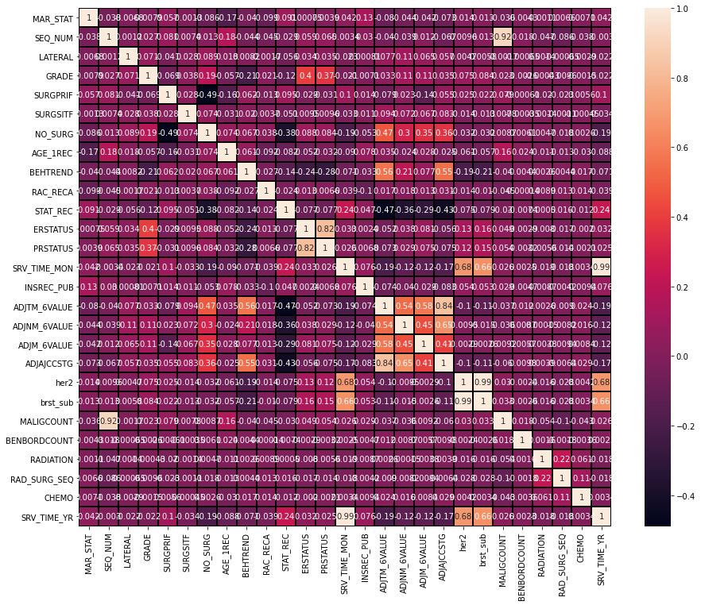
Data Cleaning (Cont.)
It is seen that some of the attributes are strongly correlated with each other. However, they were not removed because they are very significant for the model study.
We check for multicollinearity
Notes:
Rishu

Slide 8
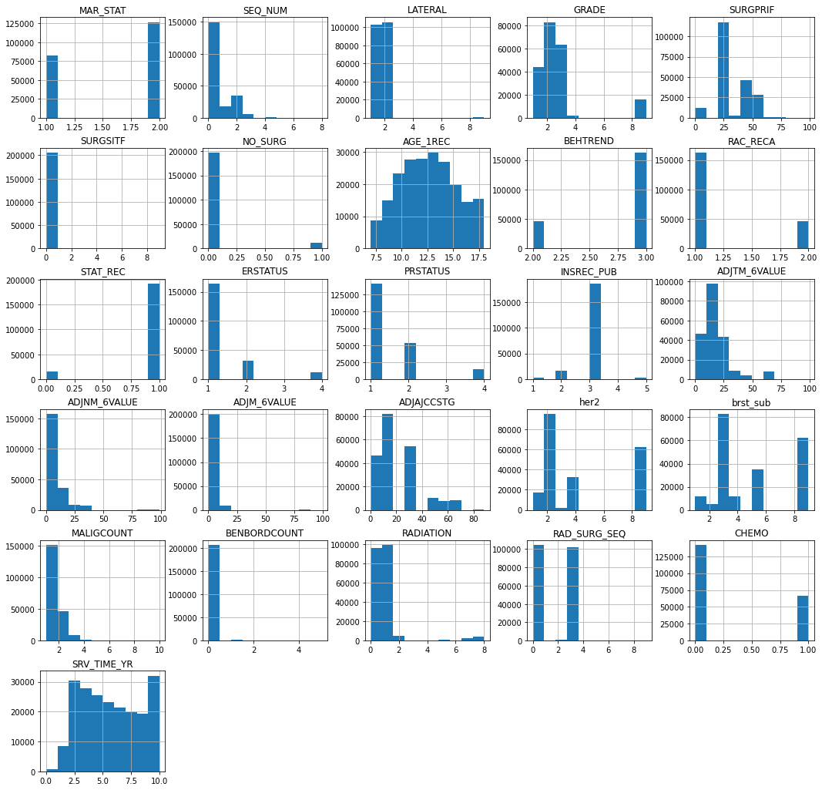
Data Cleaning (Cont.)
It can be evident that the datasets have skewness in some of the attributes however it was not normalized because these records are significant in the study; eliminating these data records can compromise study models and final result. Therefore, they were kept for future studies.
We check for skewness
Notes:
Rishu
Also, all records are categorical in nature

Slide 9
Data Preprocessing
We combine categories for certain attributes (i.e. no surgery attribute combined into Boolean of surgery, or no surgery performed regardless of the reason)
Drop all male patients, negligeable representation
Perform a binary split to categories patients that survived for more than 6 years and 6 years or less.
After this cleaning, we are left with 208,517 records
Notes:
Fady

Slide 10


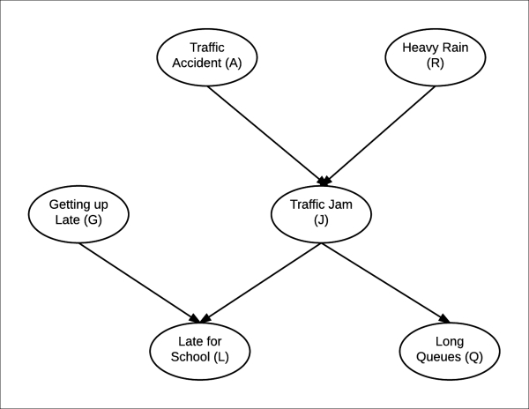
Methodology
RNN Model
Regression Analysis
Bayesian Network Model
https://www.kpl.gov/catalog/item/?i=ent://LYNDA/0/LYNDA:104159
https://francescolelli.info/tutorial/neural-networks-a-collection-of-youtube-videos-for-learning-the-basics/
https://static.packt-cdn.com/products/9781784394684/graphics/B04016_01_64.jpg
Notes:
Fady

Slide 11
RNN Model
RNN represented the best model performance for us (90% accuracy)
Baseline Deep Neural Network had a maximum accuracy of (86%)
Improved on previous research results
Not a deep RNN structure
Notes:
Fady

Slide 12
RNN Model (Cont.)
Model Structure
Parameters | RNN
Target Classes | < = 6 years and > 6 years
No. of Hidden Layers | 2
No. of Neuron in each hidden layer | 64 and 32 respectively
Activation Function in hidden layers | relu
Activation Function in output layer | sigmoid
Loss Function | Binary_crossentropy
Optimizer | Adam (lr = 0.0001)
No. of Epochs | 100
Dropout layers for Regularization | 0.1
Notes:
Fady

Slide 13
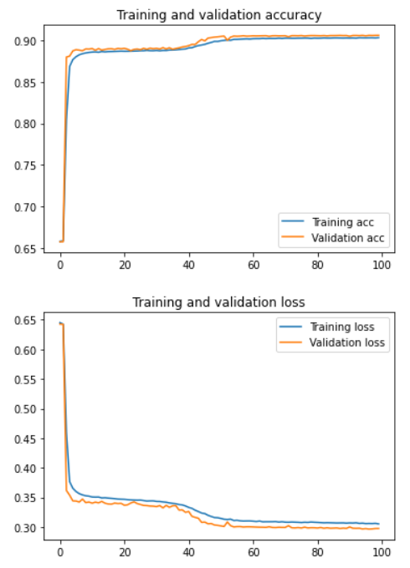
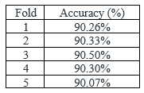
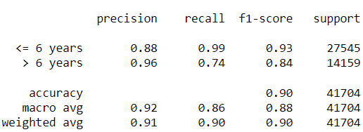
RNN Model (Cont.)
Cross Validation
Notes:
Fady
Rather have lower recall on > 6 years than on <= 6 years
<= 6 years
TP: patient lives <=6, we predict <=6
FN: patient lives <= 6, we predict >6
>6 years
TP: patient lives >6, we predict >6
FN: patient lives >6, we predict <=6
Recall: TP/(TP + FN)
Precision: TP/(TP + FP)

Slide 14
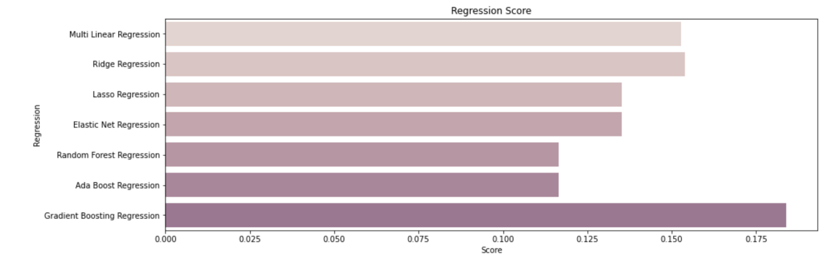
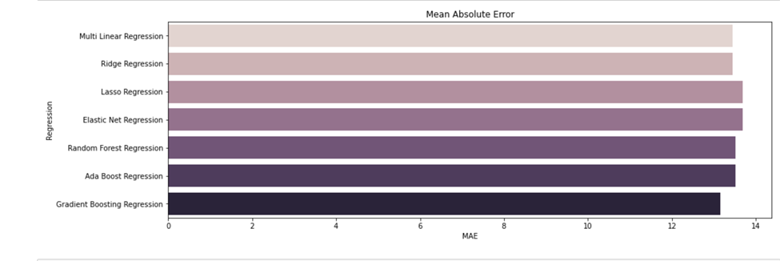
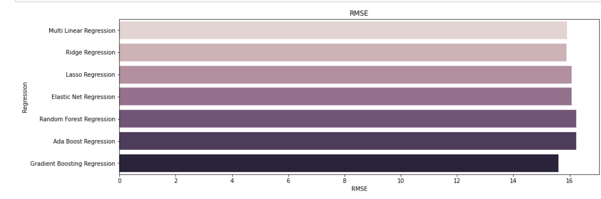
Previous Work- Linear Regression Analysis
X = all features except Survival Months, Patient ID, Year of Diagnosis, and Survival Category
Y = Survival Months
Notes:
Rishu

Slide 15
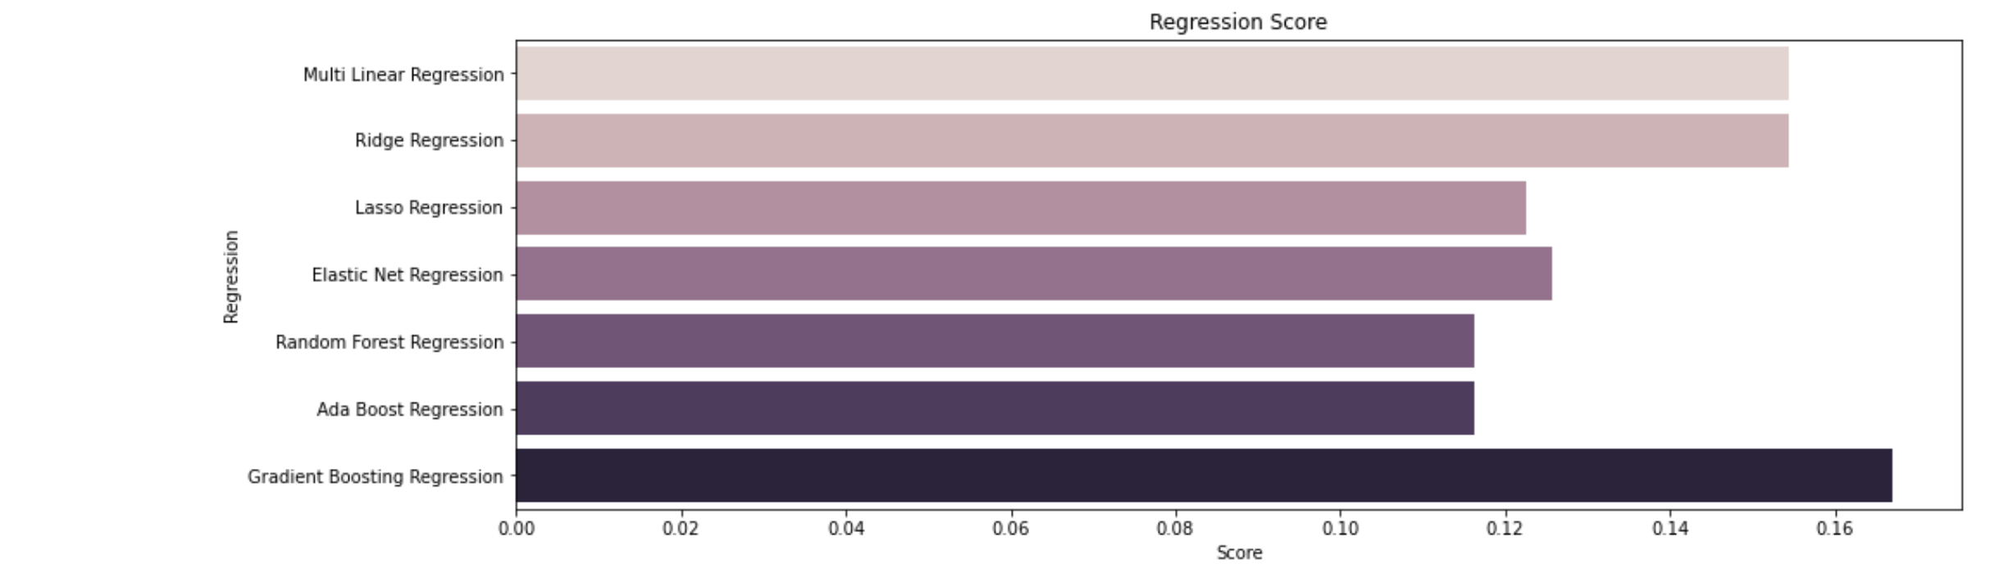
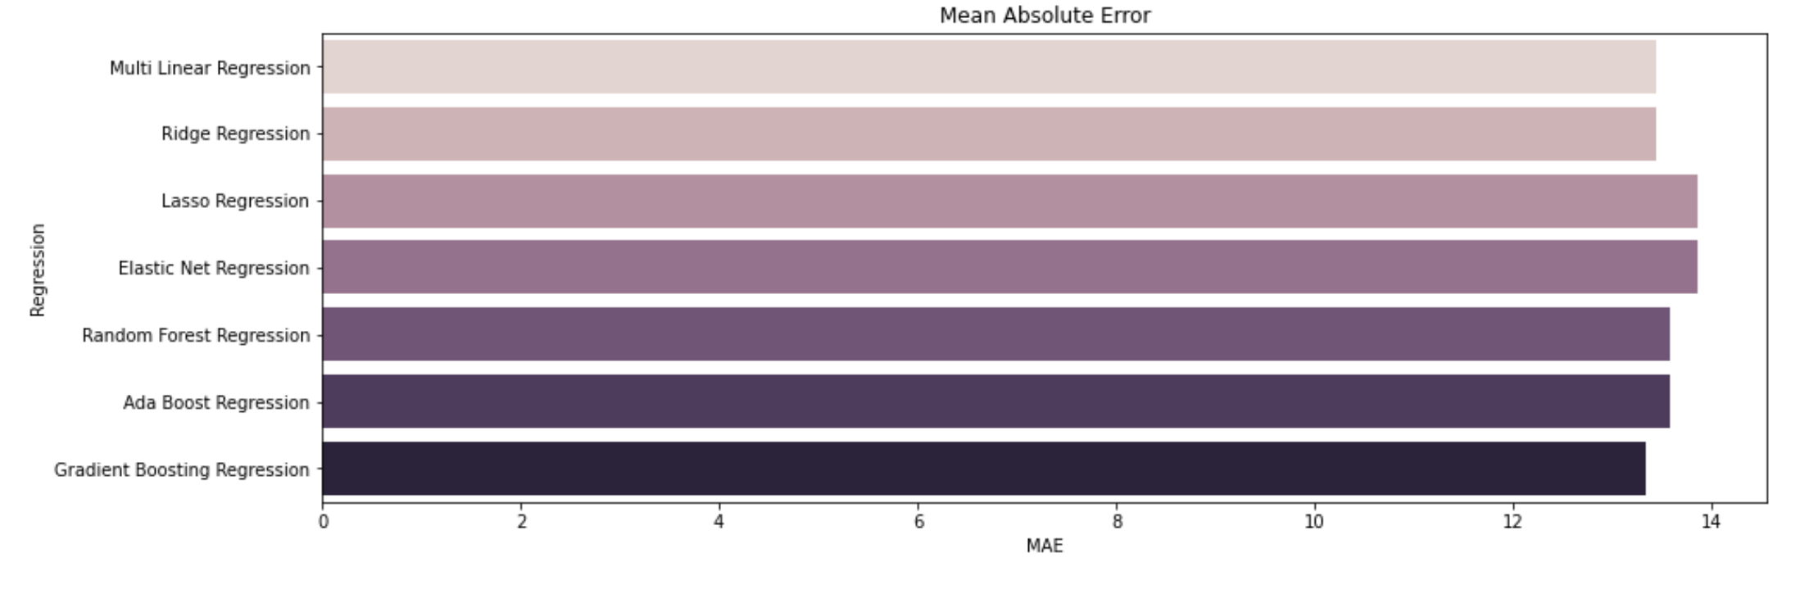
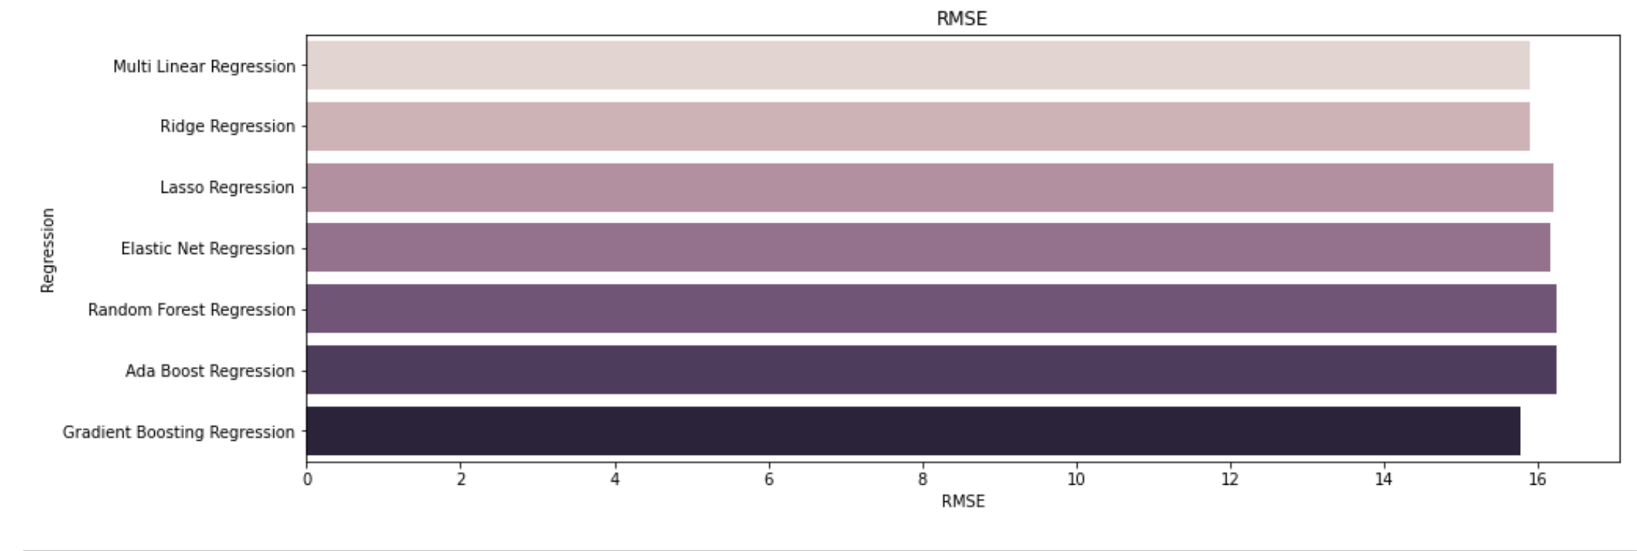
Previous Work- Linear Regression Analysis with PCA
X = all features except Survival Months, Patient ID, Year of Diagnosis, and Survival Category
Y = Survival Months
Notes:
Rishu

Slide 16
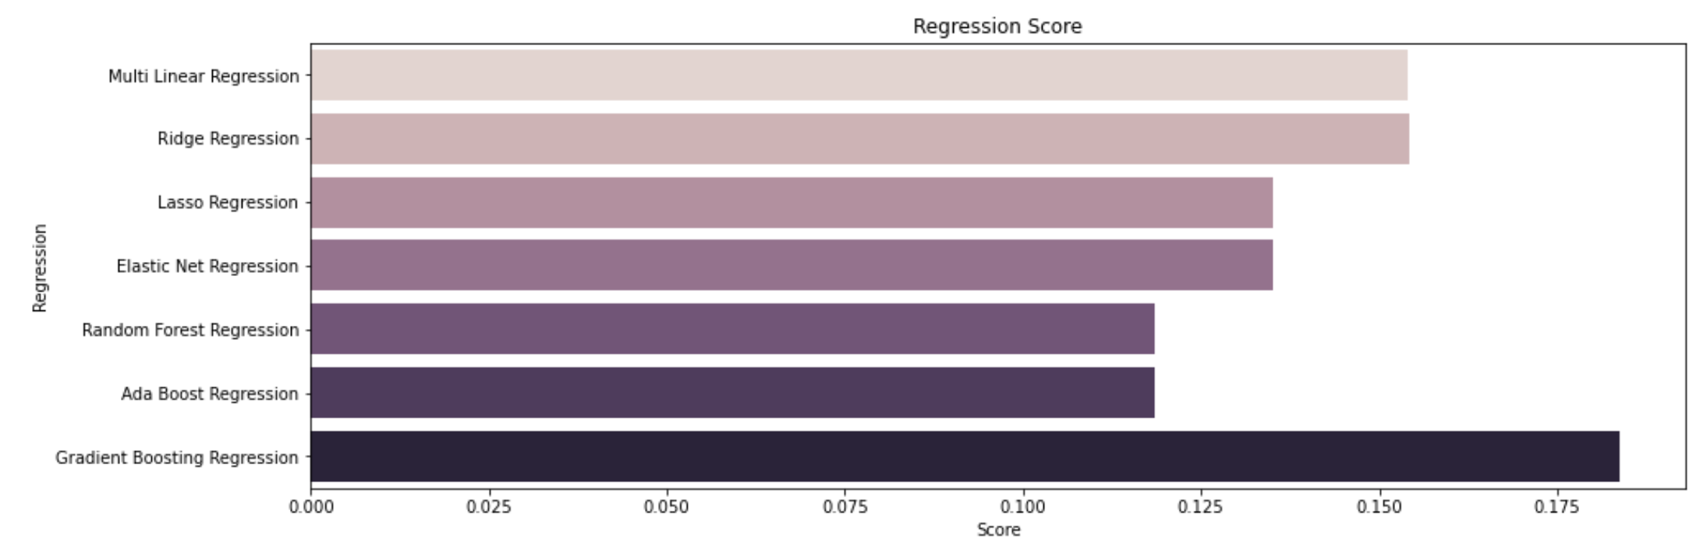
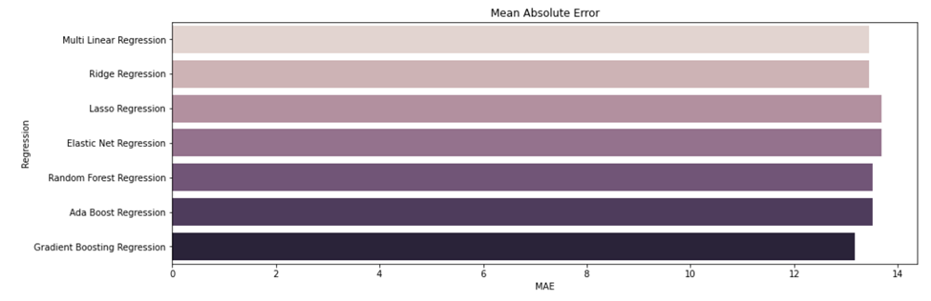
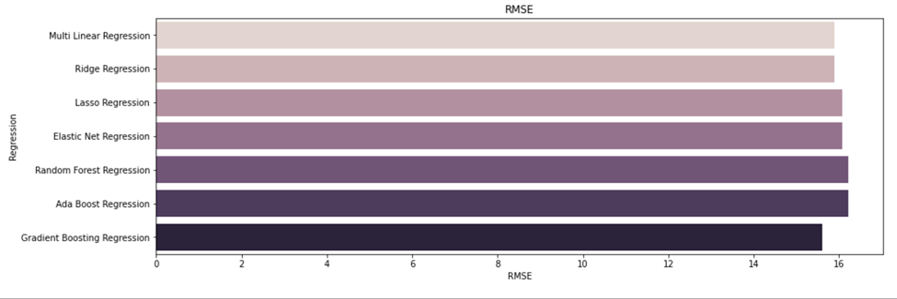
Previous Work- Linear Regression Analysis with Reduced Variables/No PCA
X = all features except Survival Months, Patient ID, Year of Diagnosis, and Survival Category, HISTO2V, ADJM_6VALUE
Y = Survival Months
Notes:
Rishu

Slide 17
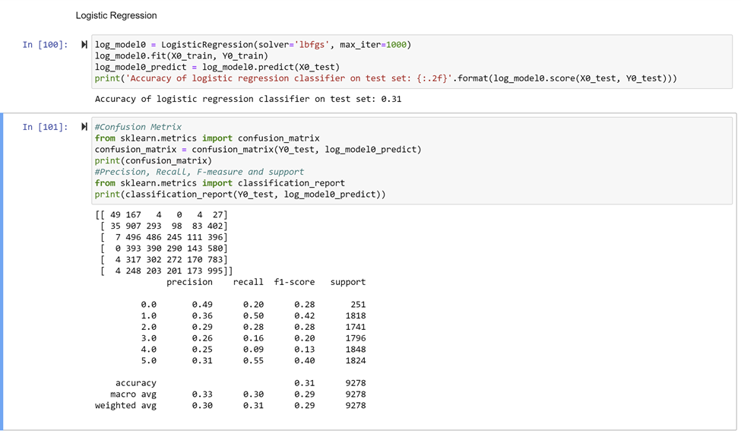
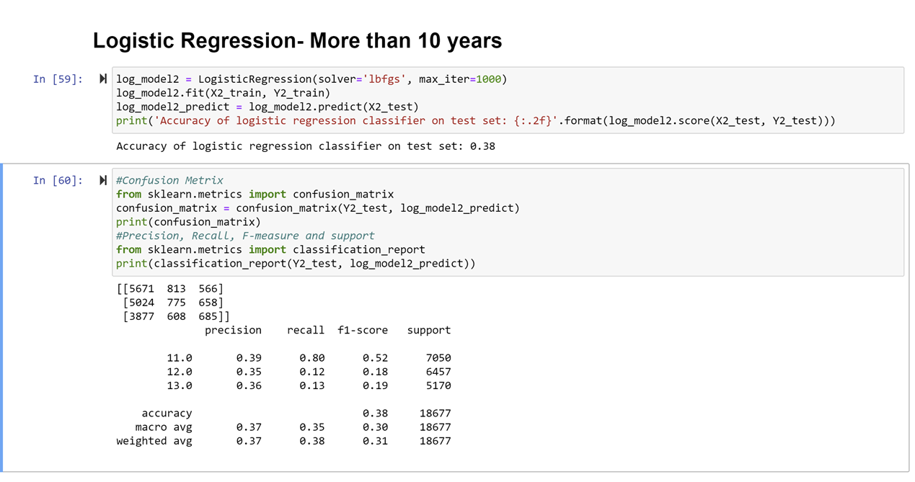
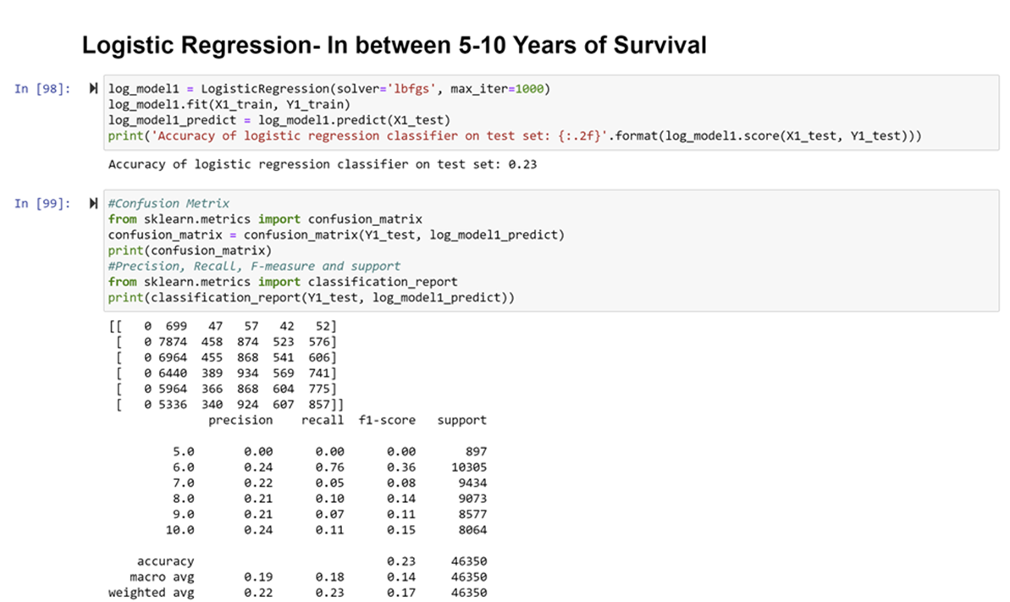
Previous Work- Logistic Regression
Notes:
Rishu

Slide 18
Logistic Regression Analysis
Model 1_Logistic Regression with PCA Analysis: less than 6 years of survival patients records
Model 2_Logistic Regression with PCA Analysis: more than 6 years of survival patients records
Train and Test: 80/20 split
X = all features except Survival Years
Y = Survival Years
Notes:
Rishu

Slide 19
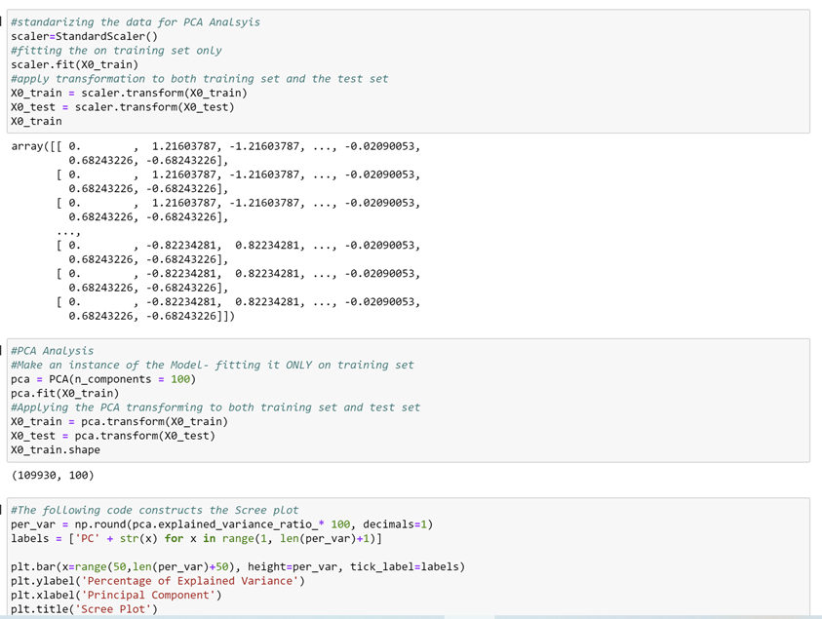
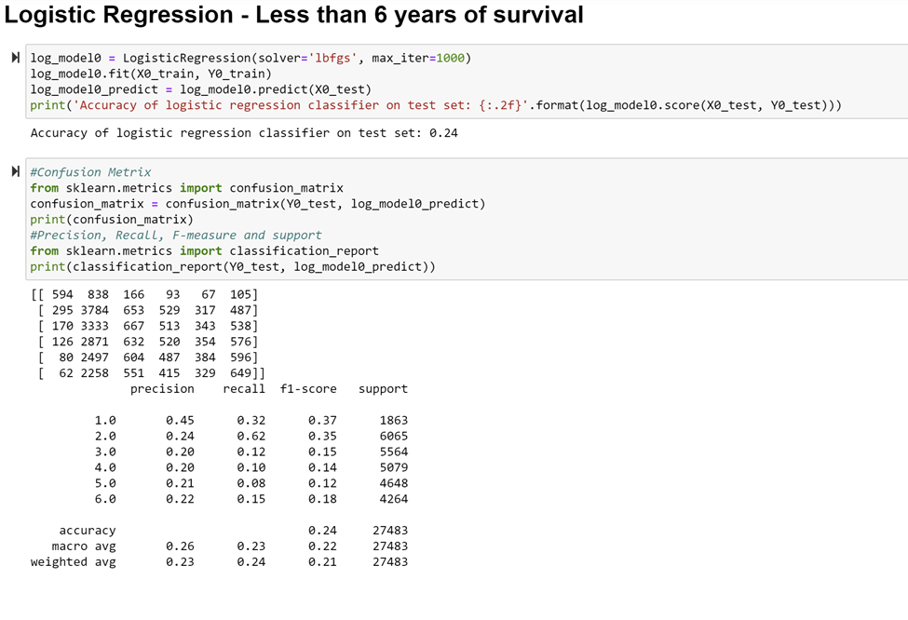
Logistic Regression Model 1
Notes:
Rishu

Slide 20
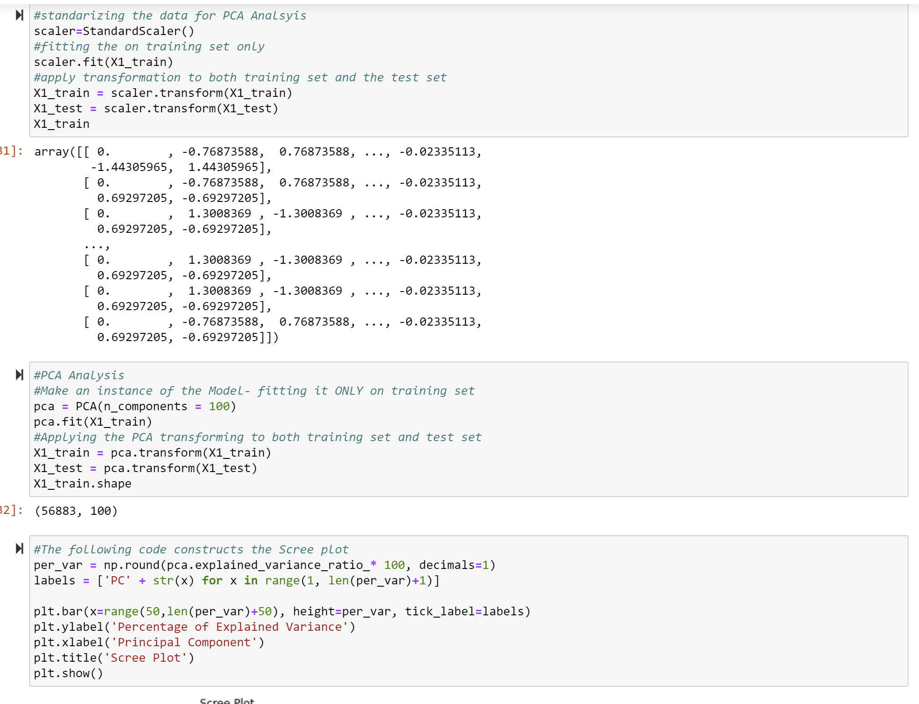
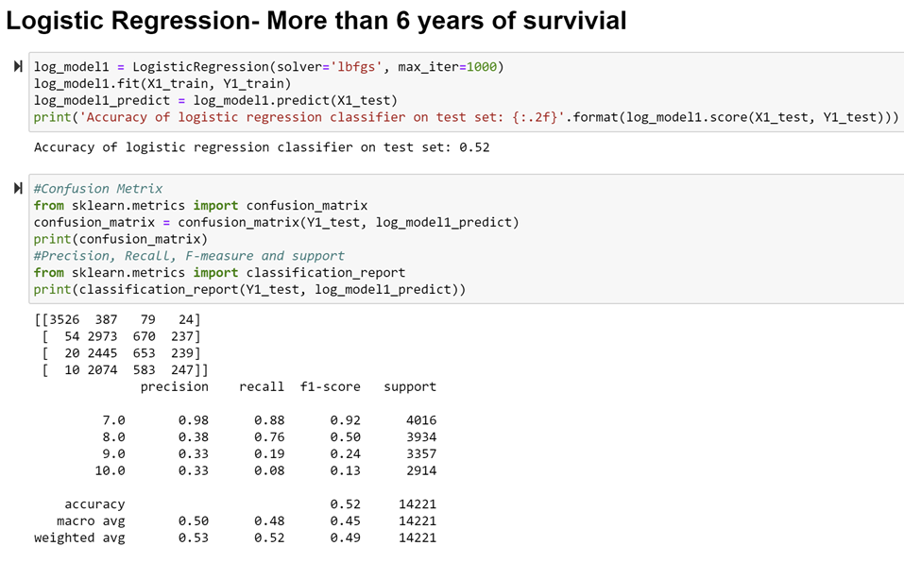
Logistic Regression Model 2
Notes:
Rishu

Slide 21
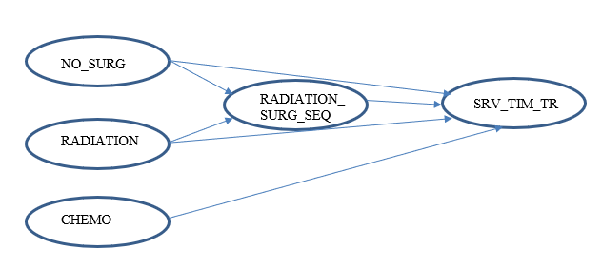
Bayesian Network Model Exploration
Notes:
Fady

Slide 22
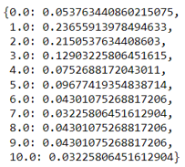
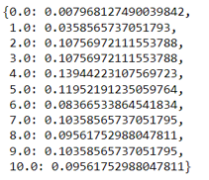
Bayesian Network Model Exploration (Cont.)
Survival Probabilistic Distributions given that the patient had chemotherapy, has had a surgery, had Beam radiation, and had radiation before surgery.
Survival Probabilistic Distributions given that the patient had chemotherapy, did not have a surgery, had Beam radiation.
Notes:
Fady

Slide 23
API Demonstration
Notes:
Fady

Slide 24

Questions ?
Notes:
Fady

Slide 25
Related solutions / State of Art
Li, J. L., Zhou, Z. Z., Dong, J. D., Fu, Y. F., Li, Y. L., Luan, Z. L., & Peng, X. P. (2021, April 16). Predicting breast cancer 5-year survival using machine learning: A systematic review. PubMed Central (PMC). https://www.ncbi.nlm.nih.gov/pmc/articles/PMC8051758/
Montazeri, M. M., Montazeri, M. M., Montazeri, M. M., & Beigzadeh, A. B. (2016). Machine learning models in breast cancer survival prediction. PubMed. https://pubmed.ncbi.nlm.nih.gov/26409558/
Ganggayah, M. D., Taib, N. D., Har, Y. C., Lio, P., & Dhillon, S. K. (2019, March 22). Predicting factors for survival of breast cancer patients using machine learning techniques. BMC Medical Informatics and Decision Making. https://bmcmedinformdecismak.biomedcentral.com/articles/10.1186/s12911-019-0801-4
Mihaylov, I., Nisheva, M., & Vassilev, D. (2019). Application of Machine Learning Models for Survival Prognosis in Breast Cancer Studies †. MDPI. https://www.mdpi.com/2078-2489/10/3/93
Hareendran, A. S., Chandra, V., Prasad, S. R., & Dhanya, S. (2020, July 14). Deep Learning Strategies for Survival Prediction in Prophylactic Resec. SpringerLink. https://link.springer.com/chapter/10.1007/978-3-030-53956-6_53
Kourou, K. K., Exarchos, T. P., Exarchos, K. P., Karamouzis, M. V., & Fotiadis, D. I. (2015, January 1). Machine learning applications in cancer prognosis and prediction. ScienceDirect. https://www.sciencedirect.com/science/article/pii/S2001037014000464

